Slide 1
Islam and Human Rights: Europe and Beyond
David Kirkham,
Senior Fellow for Comparative Law and International Policy
International Center for Law and Religion Studies
BYU Law School
Notes:
Good morning…

Slide 3
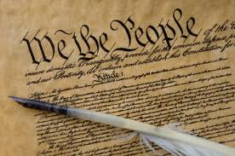
True religion constitutional government SOUND EDUCATION

Slide 4
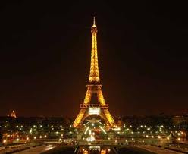
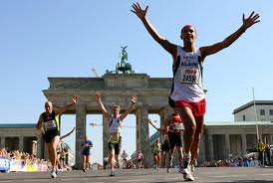
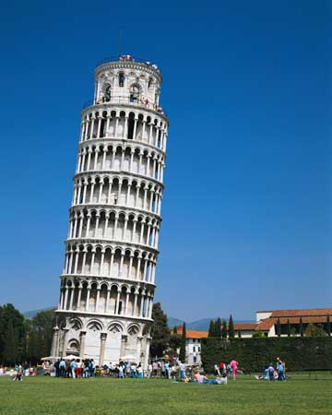
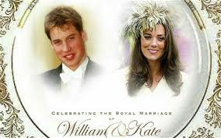
WHY EUROPE?
“Western” and Islamic co-existence, with some tension
Role model for human rights and democratic values
European Court of Human Rights

Slide 5
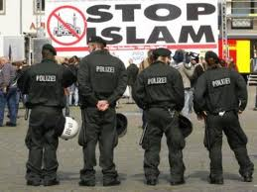
Protection of Rights of Muslims?

Slide 6
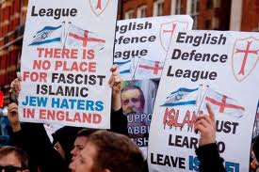
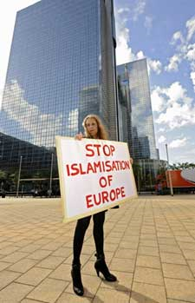
Anti-Immigration in Europe
http://www.npr.org/2011/04/27/135745530/far-right-parties-gain-ground-in-european-politics

Slide 7
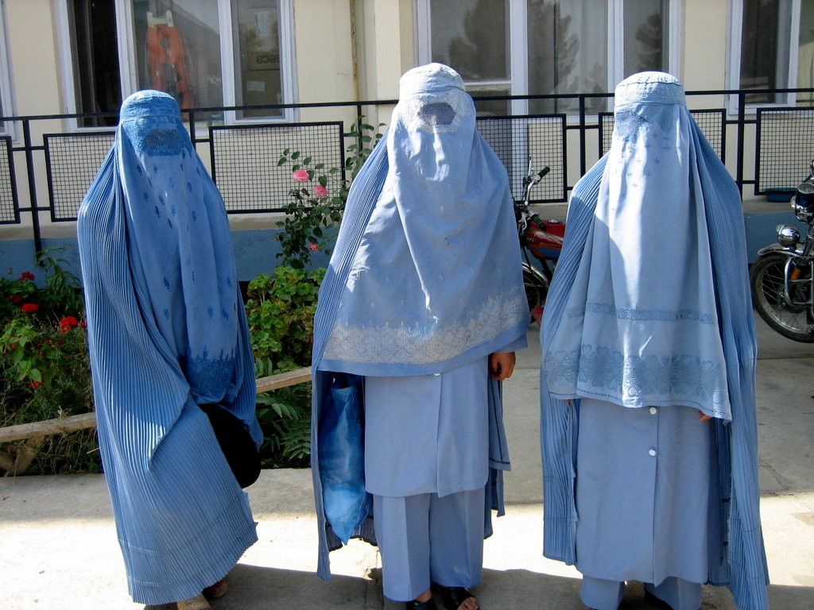
French “Burqa Ban”
"No one may, in a public place, wear an article of clothing which obscures the face" Law of the 11th of October 2010 (enforced as of the 11th of April, 2011)

Slide 8
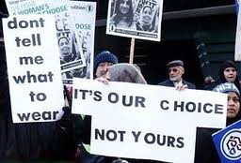
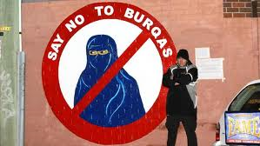
Protests on Both Sides
of the Issue of Burqas

Slide 9
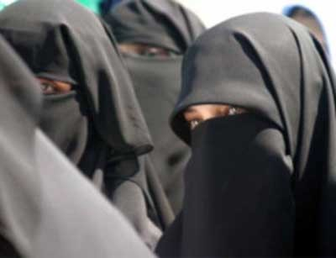
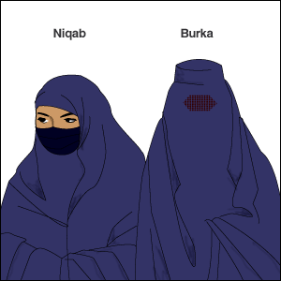
Burqa and Niqab

Slide 10
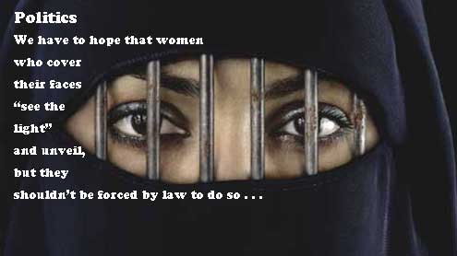

Slide 11
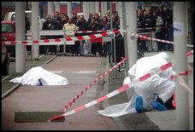
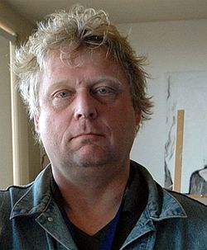
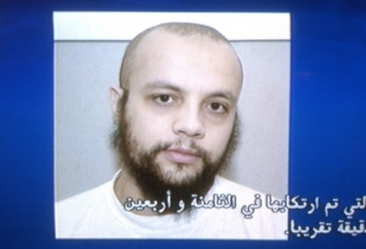
Theo van Gogh 1957-2004

Slide 12
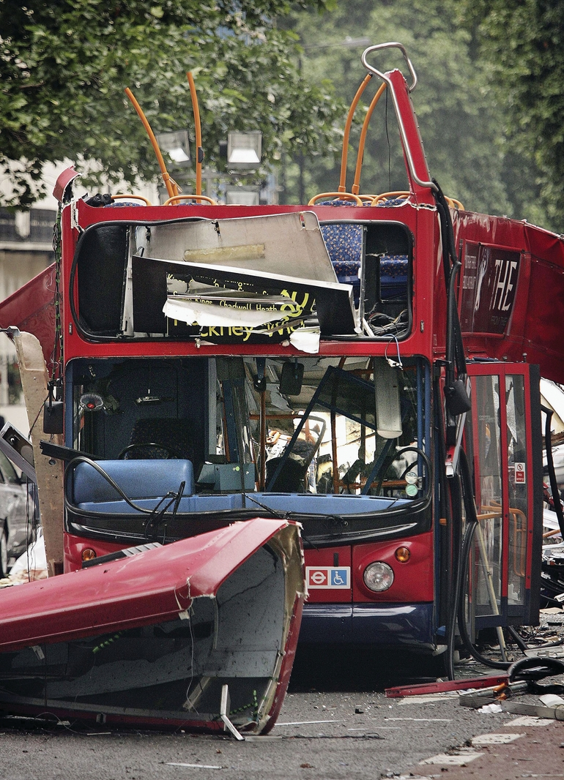
London Bombings of 7 July 2005

Slide 13
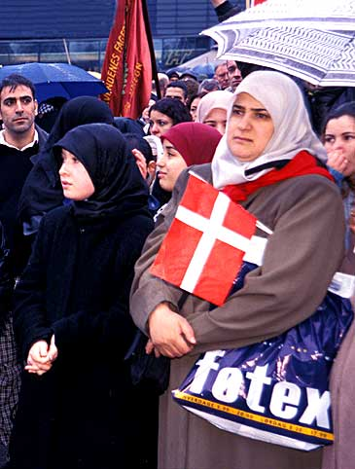
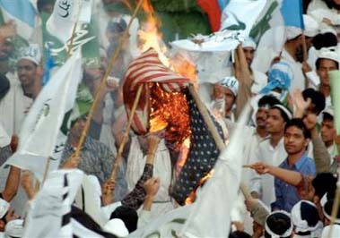
Danish Cartoons Crisis
Printed in Jyllands-Posten on September 30, 2005

Slide 14
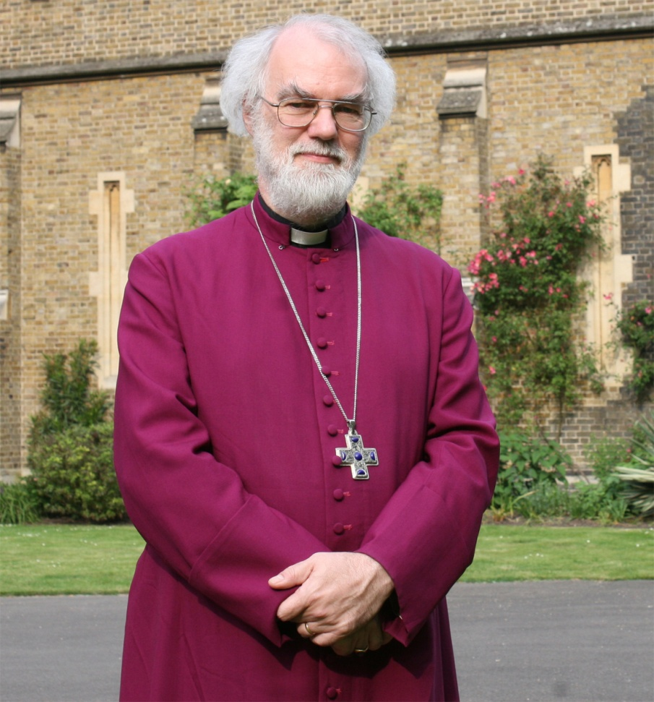
Archbishop of Canterbury Rowan Williams “It seems unavoidable and, as a matter of fact, certain conditions of Sharia are already recognised in our society.” February 2008

Slide 15
“Our general position is that sharia law cannot be used as a justification for committing breaches of English law, nor should the principles of sharia law be included in a civil court for resolving contractual disputes.”

Slide 16
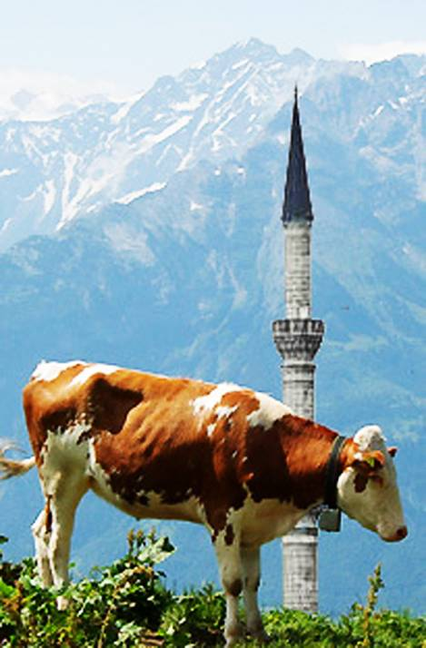
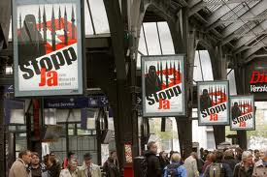
Swiss Minaret Ban of November 2009

Slide 17
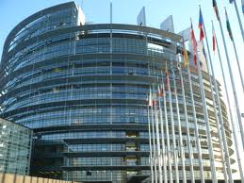
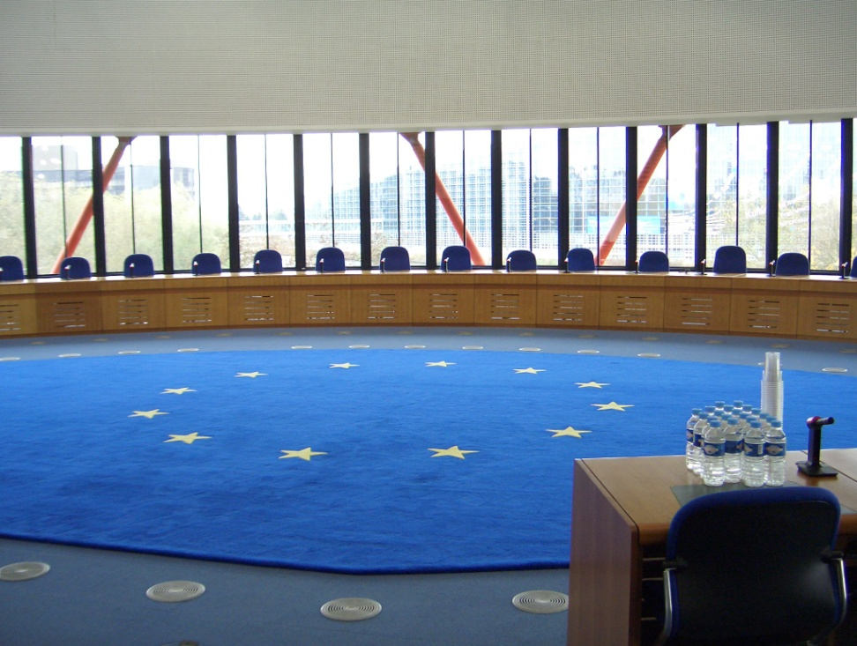
European Court of Human Rights

Slide 18
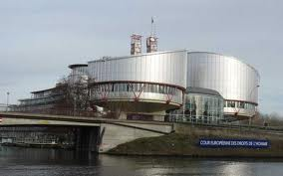
European Court of Human Rights
An international court established in 1959 by
Council of Europe (47 countries, 800 million citizens)
“Quasi-enforceable”
Rules on individual or State applications
alleging violations of civil and political rights
set out in the European Convention on Human
Rights
Individuals can apply directly
Since 1998 a full-time court
Located in Strasbourg, France
http://www.echr.coe.int/NR/rdonlyres/DF074FE4-96C2-4384-BFF6-404AAF5BC585/0/Brochure_en_bref_EN.pdf

Slide 19
European Court of Human Rights
The Prohibitions
torture and inhuman or degrading
treatment or punishment
slavery and forced labour
death penalty
arbitrary and unlawful detention
discrimination in the enjoyment of the
rights and freedoms set out in the Convention.
The Guarantees
the right to life
the right to a fair hearing
the right to respect for
private and family life
the protection of property
freedom of expression
freedom of thought
conscience and religion

Slide 20
Some Key Cases at the European Court of Human Rights

Slide 21
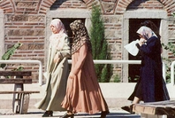
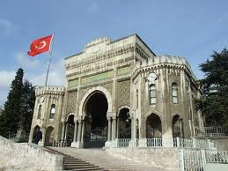
Leyla Sahin v. Turkey

Slide 22
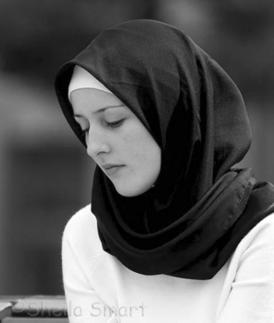
Hijab

Slide 23
Refah Partisi and the ECHR

Slide 24
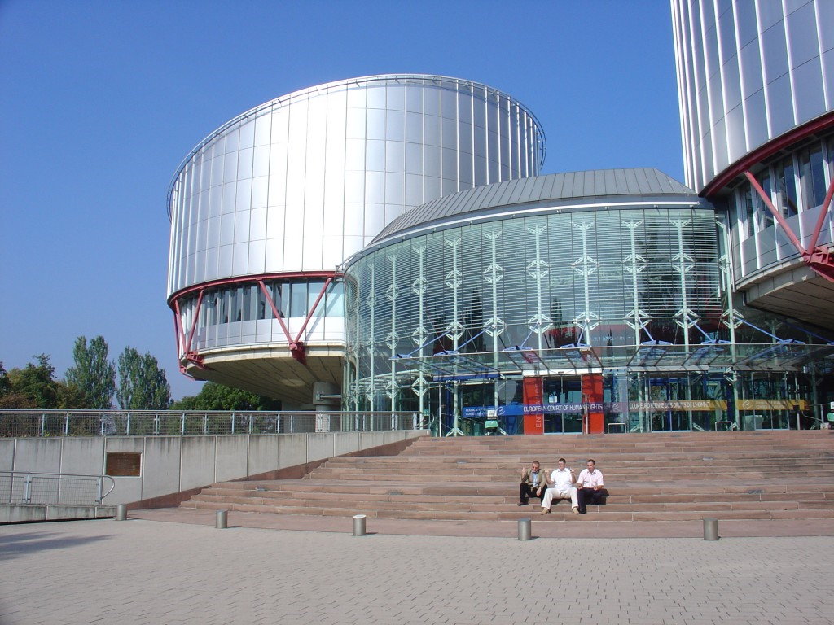

Slide 25
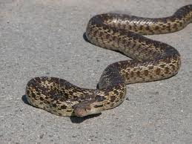
Wise as Serpents Harmless as Doves

Slide 26
True religion constitutional government SOUND EDUCATION

